Slide 1
IOC and DI

Slide 2
IOC and DI
INVERSION OF CONTROL
DEPEDENCY INJECTION
DIP

Slide 3
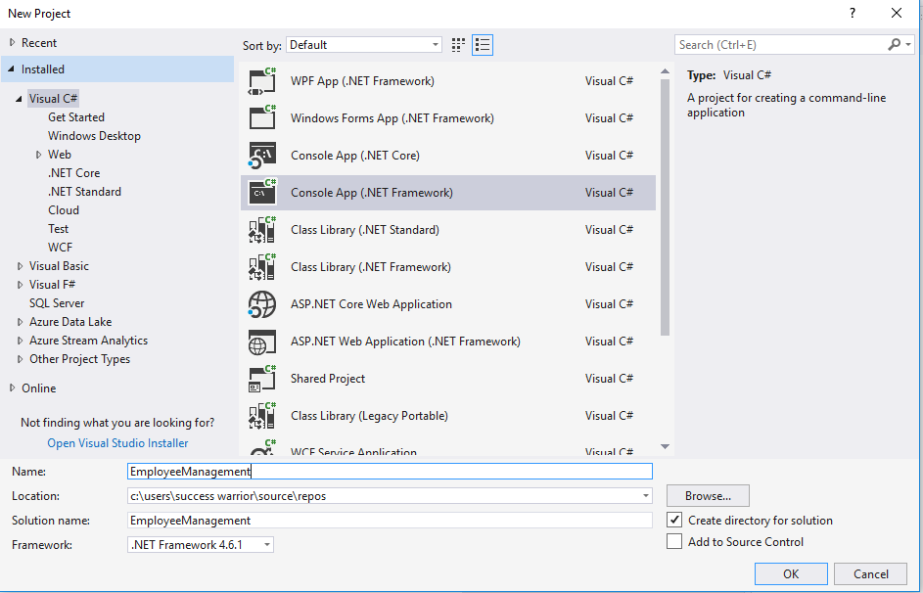

Slide 4
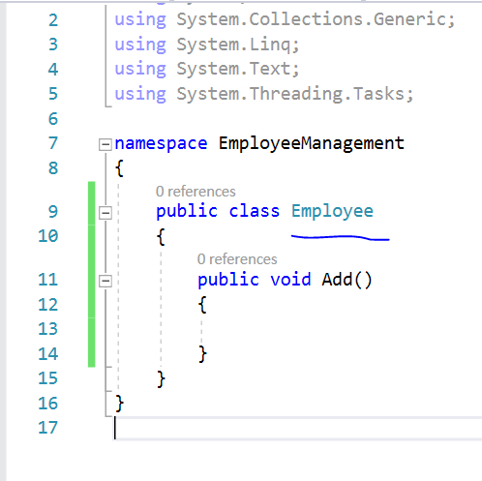
Add new class
With one method
Add which helps to
Add new employee

Slide 5
Now Assume we have two different DAL in this application
Using ORACLE and SQL
And we can use any one of them while adding new employee

Slide 6
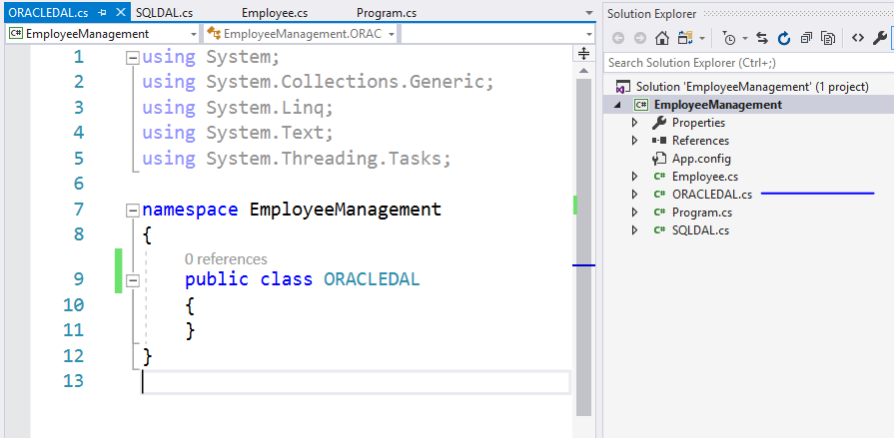
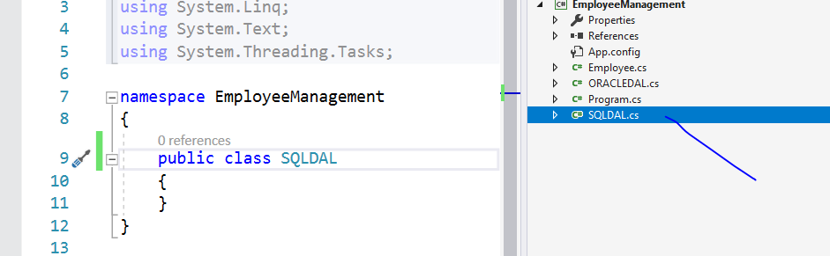

Slide 7
Now as we all know DIP we know that we should make one interface as an abstraction which can help me to keep these two DAL layers connected with my employee class

Slide 8
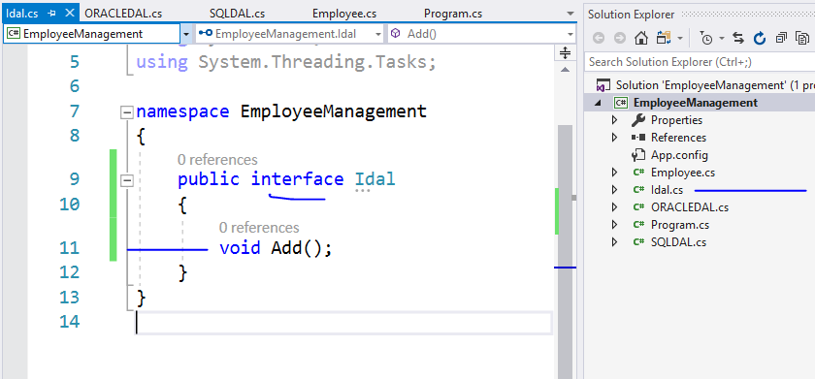

Slide 9
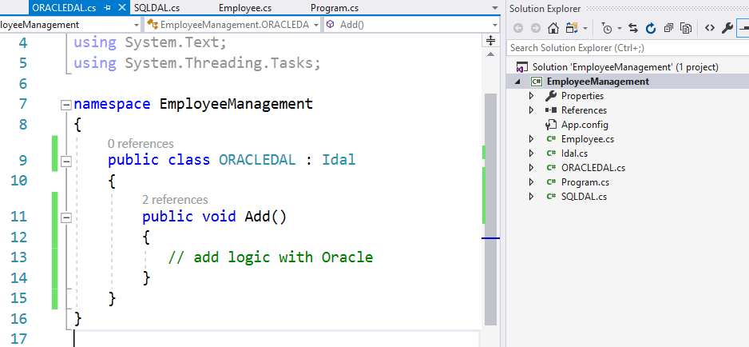

Slide 10
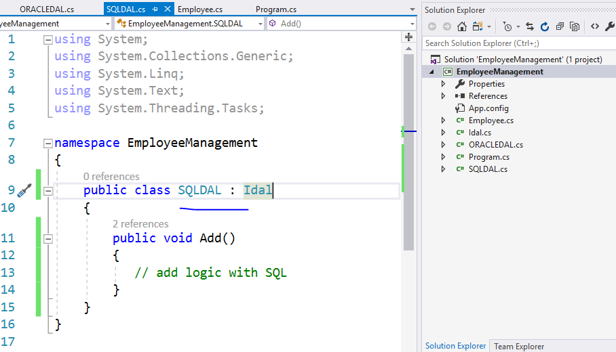

Slide 11
Now it’s a time to do runtime polymorphism
Inside Employee Class so that we can associate with any DAL at runtime

Slide 12
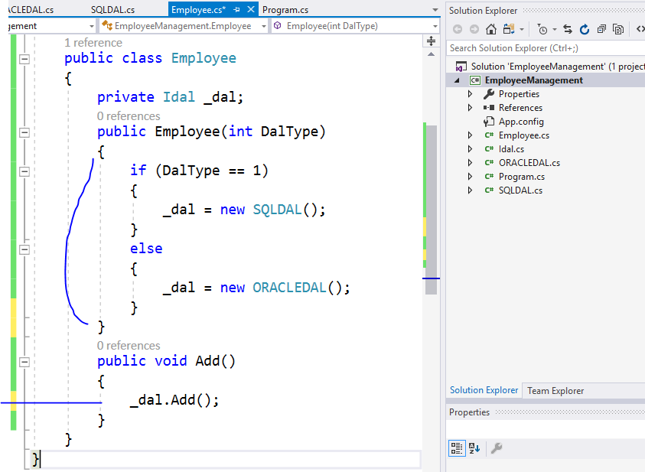

Slide 13
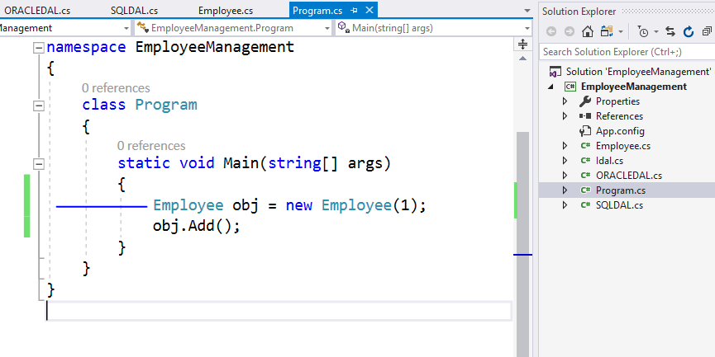
This will create SQLDAL object
While creating employee object

Slide 14
Now this will work fine
BUT
But in this case employee object is deciding DAL based on DalType parameter

Slide 15
The actual work of Employee class is just take of Add method the decision making power to control which DAL has to be chosen should be shifted to someone else

Slide 16
The solution of this problem is we will invert this controlling power to somewhere else and employee will be only focused on add method

Slide 17
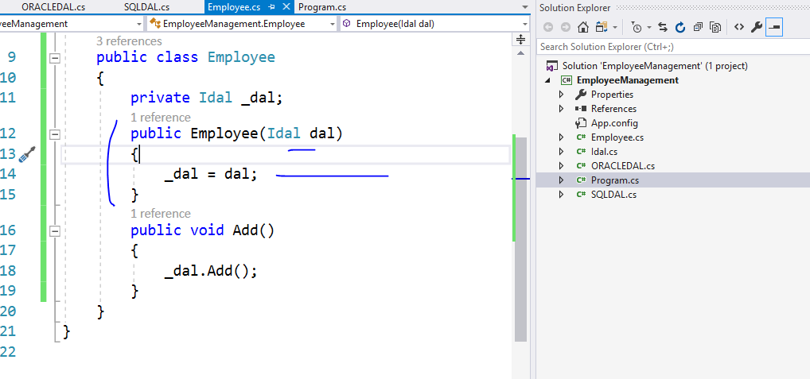

Slide 18
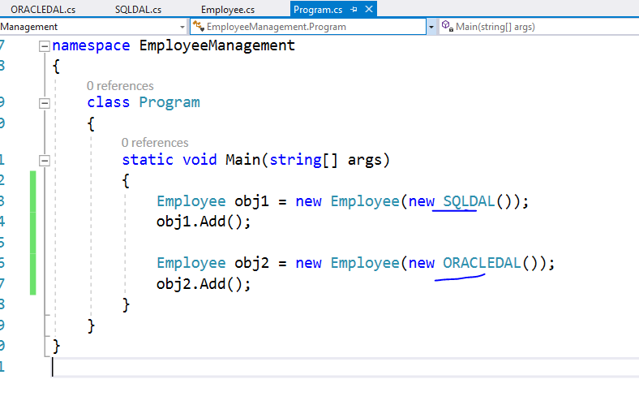

Slide 19
Because of IOC you will get loosely coupled system and much cleaner code which is easy to maintain
We can do IOC by using Events, delegates but the one which we have done here is using constructor DI

Slide 20
In number of framework there are many IOC containers which helps us to do DI with ease
Castle Windsor
Spring.NET
Autofac
Unity
All containers use factory pattern to do DI and there are few internal containers also in .Net framework specially for MVC

Slide 21
Creational
Structural
Behavioral
Factory
Abs Factory
Builder
Prototype
Singleton
Adaptor
Bridge
Composite
Decorator
Façade
Flyweight
Proxy
Chain of Resp..
Command
Iterator
Interpreter
Mediator
Observer
Momento
State
Visitor
Strategy
Repository
DI

